Slide 1

CRUISE CONTROL SYSTEM
Supervised By :
Eng. Ahmed Kamal

Slide 2
OUR TEAM
Aya Adel Gomaa
Omar Ahmed Fahmy
Mohamed Ahmed Khalil
Mario Refaat
Hazem Ihab
Abd El Karim
Diaa Ayman
Fatma El Zahraa

Slide 3
Outlines
1
Overview
2
System Flow
3
Software Layered Architecture
4
First Microcontroller
MC 1 Software Architecture
MC 1 Detailed-Description
5
Second Microcontroller
MC 2 Software Architecture
MC 2 Detailed-Description
6
Testing and Corner Cases

Slide 4
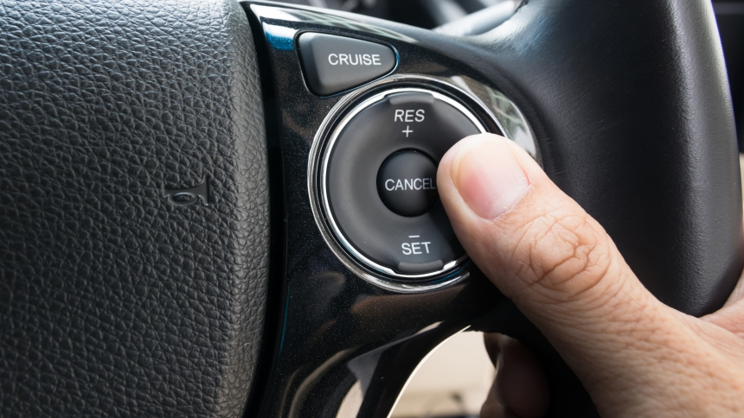
Overview
Cruise Control System – also known as Speed Control System.
System that automatically controls the speed of a motor.

Slide 5
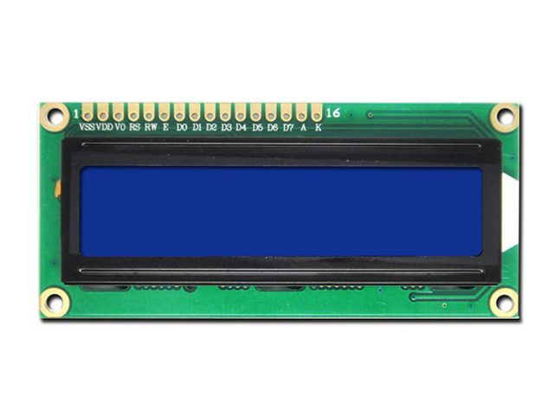
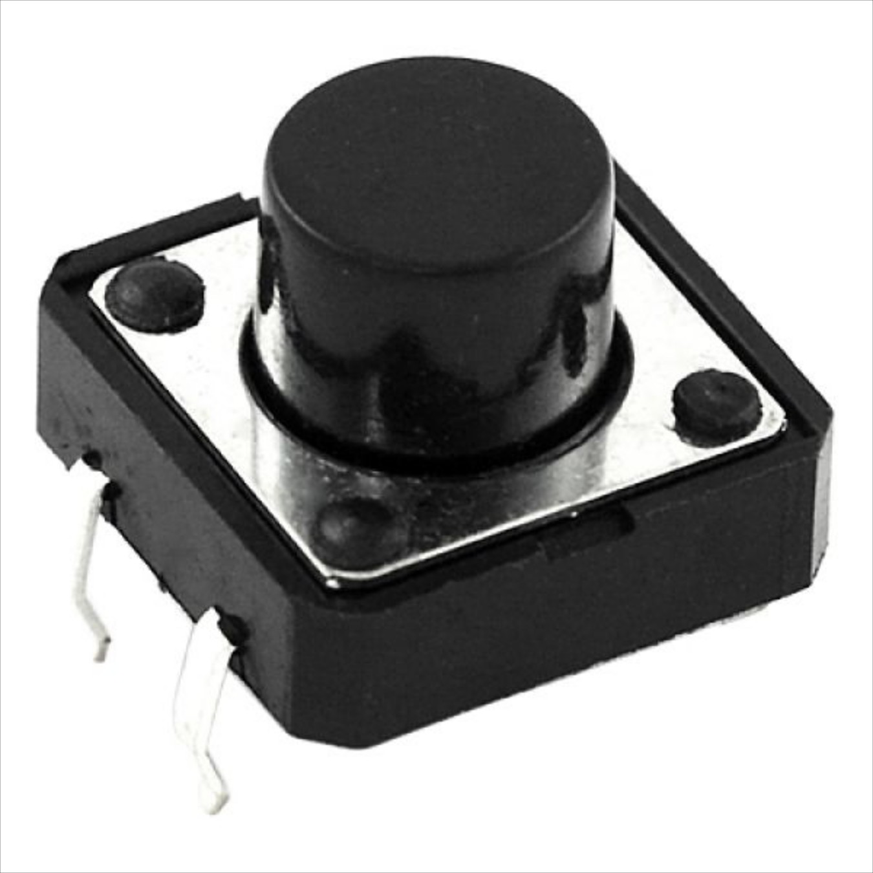
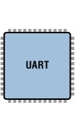
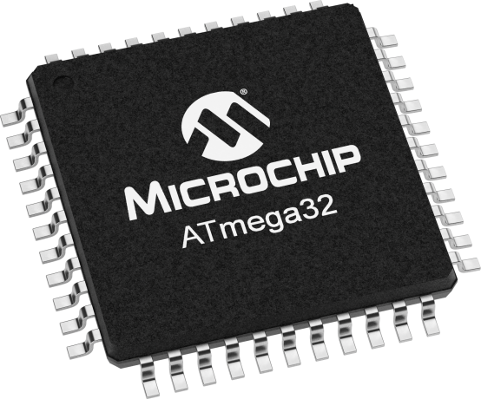
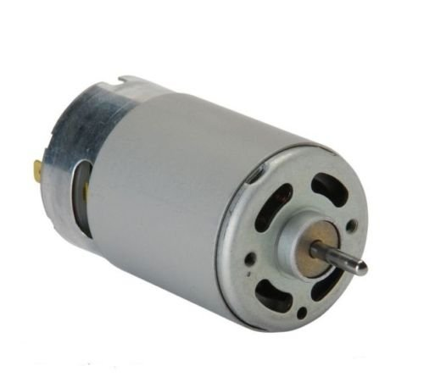
System Flow

Slide 6
Software Layered Architecture
APP
Call Direction
HAL
LIB
MCAL

Slide 7
First
Microcontroller

Slide 8
MC 1 Software Architecture
MC 1 Architecture
Layers
APP
HAL
MCAL
LIBRARIES
Main
UART
STD Types
External Interrupts
Bit Math
DIO
AVR Registers

Slide 9
MC 1 Detailed-Description
Cycles Array
0 | 10 | 20 | 30 | 40 | 50 | 60 | 70 | 80 | 90 | 100
Cycle Pointer
Send 50 to MC 2
0 | 10 | 20 | 30 | 40 | 50 | 60 | 70 | 80 | 90 | 100
EXTERNAL INTERRUPT 0
Push Button 1
Cycle Pointer
Send 60 to MC 2
0 | 10 | 20 | 30 | 40 | 50 | 60 | 70 | 80 | 90 | 100
Push Button 2
EXTERNAL INTERRUPT 1
Cycle Pointer
Send 40 to MC 2

Slide 10
Second
Microcontroller

Slide 11
MC 2 Software Architecture
MC 2 Architecture
Layers
APP
HAL
MCAL
LIBRARIES
Main
LCD
UART
STD Types
Motor
PWM
Bit Math
DIO
AVR Registers

Slide 12
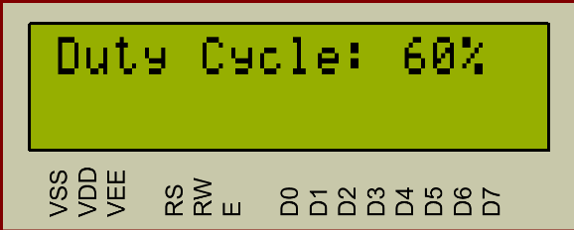
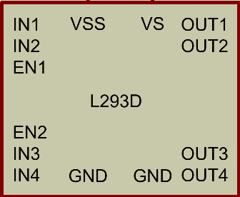
MC 2 Detailed-Description
RECEIVE INTERRUPT
Duty Cycle n
Store Received
Current
Print n%
from MC1
Value
PWM Signal Mapping

Slide 13
Testing &
Corner Cases

Slide 14
Testing
Test Case | Status
MC1
 | Pass
 | Pass
MC2
 | Pass
 | Pass
 | Pass
Final Testing
 | Pass
Transmitting a Byte
Validating External Interrupts
Validating UART Receiving Interrupt
Displaying on LCD
Controlling the motor’s speed using PWM
Increasing and decreasing the motor’s duty cycle when pressing push buttons 1 and 2 respectively, as well as displaying the correct value on LCD.

Slide 15
Corner Cases
We have two corner cases that our program can handle :
The speed of motor will never exceed 100% duty cycle
if the user tries to increase the speed above 100% duty cycle , the motor will remain at its highest speed.
The speed of motor will never go below 0% duty cycle
if the user tries to decrease the speed below 0% duty cycle , the motor will remain at rest.

Slide 16
Contribution
Member | Contribution
Aya Adel Gomaa
Omar Ahmed Fahmy
Mohamed Ahmed Khalil
Mario Refaat
MC 1 APP Layer
DIO Driver
External Interrupts Driver
MC 2 APP Layer
UART Driver
PWM Driver
Proteus Testing
Software Layered Architecture
MC 1 APP Layer
AVR Registers
DIO Driver
UART Driver
MC 2 APP Layer
Motor Driver
Proteus Testing
MC 1 APP Layer
PWM Driver
Motor Driver
Proteus Testing
Corner Cases
DIO Driver
Test Cases
External Interrupts Driver
Proteus Testing
PWM Oscilloscope Monitoring
UART Driver

Slide 17
Thank You
Any Questions?

